Slide 1
Writing JavaScript by not writing JavaScript
Andy Babiec
Boston Code Camp
10/12/2012

Slide 2
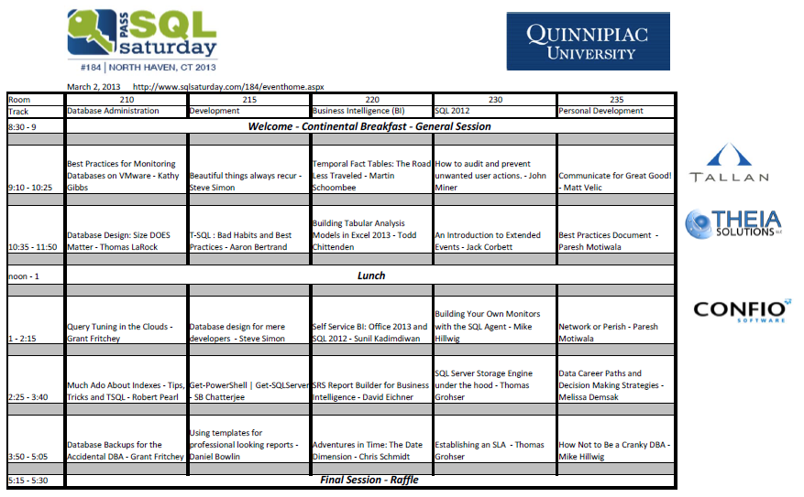

Slide 3
Agenda
JavaScript: Quirks & Pains
Alternatives
CoffeeScript
Dart
TypeScript
Script#
Google Web Toolkit

Slide 4
JavaScript: The Good Parts
Doug Crockford:
“Hidden under a huge steaming pile of good intentions and blunders is an elegant, expressive programming language. JavaScript has good parts.”

Slide 5
JavaScript - Quirks
Globalization by default
Coercion (Falsey / Truthy)
Coercive Math
Hoisting
Semi-colon insertion;

Slide 6
JavaScript - Pains
Lack of Modularization
Scoping
Solved with Namespacing
Revealed Module Pattern / Closure
Refactoring due to Dynamic nature
OO
Notes:
Hasn’t had a formal definition of classes since it was first created
What they refer to as classes are really just custom constructors used to define custom reference types.
Reference types are the closest thing to classes in JavaScript.
This is scoped under invocation. If a function is not invoked as a parent container, it is made global. (DOMWindow)

Slide 7
CoffeeScript
A language that compiles to JavaScript
Raison d'être
Uses JavaScript best practices / idioms
Around since 2009, open source
http://coffeescript.org/
Notes:
Reason for Existence

Slide 8
CoffeeScript
Whitespace-based
Inspired by JavaScript, Ruby, Python & Haskell
IDE Integration
Visual Studio: Mindscape Web Workbench
IDE support out of the box
IntelliJ, Eclipse, WebStorm, Netbeans, Sublime Text
Benefits / Downsides

Slide 9
Dart
Start with clean slate
Improve the language, DOM and tools for web development
Created by Google V8 team, open source
Over 1 year old, just hit milestone 2
http://www.dartlang.org/

Slide 10
Dart Language
Class-based, object-oriented language with lexical scoping, closures, and optional static typing
Optional types
Checked vs. Production mode
Goals
Structured yet flexible language for the web
Easy to learn/use
High performance

Slide 11
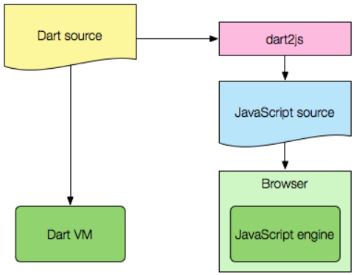
Dart Language
Usage
Run in a VM
Translate to JavaScript (dart2js)
IDE Integration
Dart Editor, Jetbrain, IntelliJ IDEA
JavaScript Library Interoperability
js.dart library

Slide 12
Dart Language
Benefits
OO, types, similarity to Java/.NET
Performance
Downsides
VM not integrated into browsers
Still in preview mode
Generated JavaScript hard to read / maintain without Dart tooling. Different semantics.

Slide 13
TypeScript
New Microsoft Project, open source
Headed by Anders Hejlsberg
http://www.typescriptlang.org/
Typed superset of JavaScript that compiles to plain JavaScript
All JavaScript code is TypeScript code
All JavaScript libraries work with TypeScript

Slide 14
TypeScript – Why?
Tackle building application-scale, maintainable JavaScript
Static checking (like JSLint), statement completion, refactoring
Organize code into dynamically-loadable modules

Slide 15
TypeScript
IDE Integration
Visual Studio (better with Web Essentials), Emacs, Vim, Sublime Text
Debugging: Source Maps
Benefits / Downsides
Comparisons to Dart & CoffeeScript
Notes:
Dart: TypeScript builds on JavaScript so there's no JS interop issues. Dart is a native virtual machine written from scratch. Dart interops with JavaScript...but it's not JS. It doesn't even use the JavaScript number type for example. Different semantics.
CoffeeScript: TypeScript’s static typing could enable better tooling with warning squiggles, easy statement completion, plus smart refactoring. You also get easy navigation around code, as well as find references, rename, and more. You don’t currently get that in CoffeeScript. CoffeeScript has additional enhancements, such as splats for variable arguments, array slicing and more.

Slide 16
Script#
Convert C# into JavaScript
Around for several years, open source
Developed and maintained by an Microsoft employee
Leverage the benefits of C# (type checking), .NET (OOP) and Visual Studio (intellisense, refactoring, etc.)
Focused on writing JavaScript libraries

Slide 17
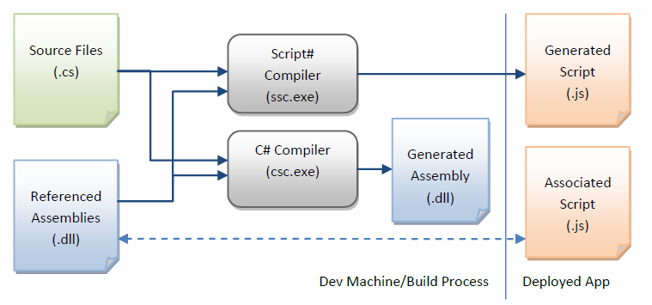
Script#

Slide 18
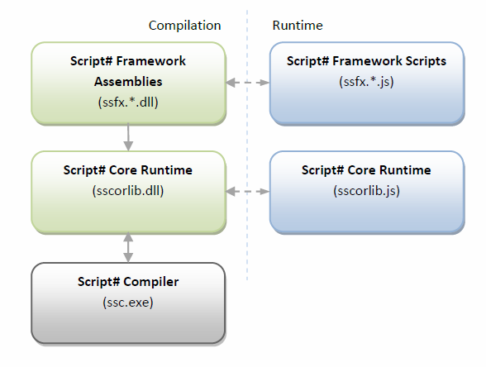
Script#

Slide 19
Script#
Mscorlib -> sscorlib.dll and sscorlib.js
Script# framework
JavaScript Library interoperability
Nuget Packages: Jquery, Knockout
Visual Studio extension
Benefits / Downsides
Notes:
Benefits
C#
Downsides
Lack of documentation
Subset of the C# language
Generated JavaScript hard to maintain w/o tool

Slide 20
Google Web Toolkit
Convert Java to JavaScript
Use Java to write AJAX apps
Around since 2005, open source
Google Project
https://developers.google.com/web-toolkit/
JavaScript Native Interface (JSNI) to call JavaScript
Notes:
How
Use the GWT SDK
GwtQuery is a jQuery-like API written in GWT
IDE integration
Eclipse
http://gwt.google.com/samples/Showcase/
Extensive documentation, books
Used to create the chrome version of Angry Birds
Downsides
Subset of Java
Google commitment?

Slide 21
Google Closure Tools
Compiler
https://developers.google.com/closure/compiler/docs/js-for-compiler
Compiles JavaScript to better JavaScript
Better performance
Code Checking using annotations in comments
Notes:
https://developers.google.com/closure/
Many things:
Closure Compiler: JavaScript Optimizer
Closure Library: JavaScript library
Closure Linter: JavaScript style checker and style fixer
Closure Sylesheets: Extensions to the standard CSS language: compiles to CSS
Closure Templates: dynamic HTML generation for Java and JavaScript

Slide 22
Review
Plenty of options to investigate
Understand the differences
ababiec@tallan.com
@ababiec
http://www.tallan.com/

